Slide 1
We will start at 9:50 on the dot. Now is a great time to ask me questions if you have any. Also, while we wait, please fill out the “Daily Discussion Question” on Canvas!

Slide 2
EPSY 3264: Basic and Applied Statistics
Instructor: Sam Ihlenfeldt
TA: Jiayi Deng

Slide 3
Agenda
Instructor Introductions
Course goals and philosophy
Course materials
Course flow
Grade breakdown
Group introduction and discussion questions
Review!
Additional resources

Slide 4
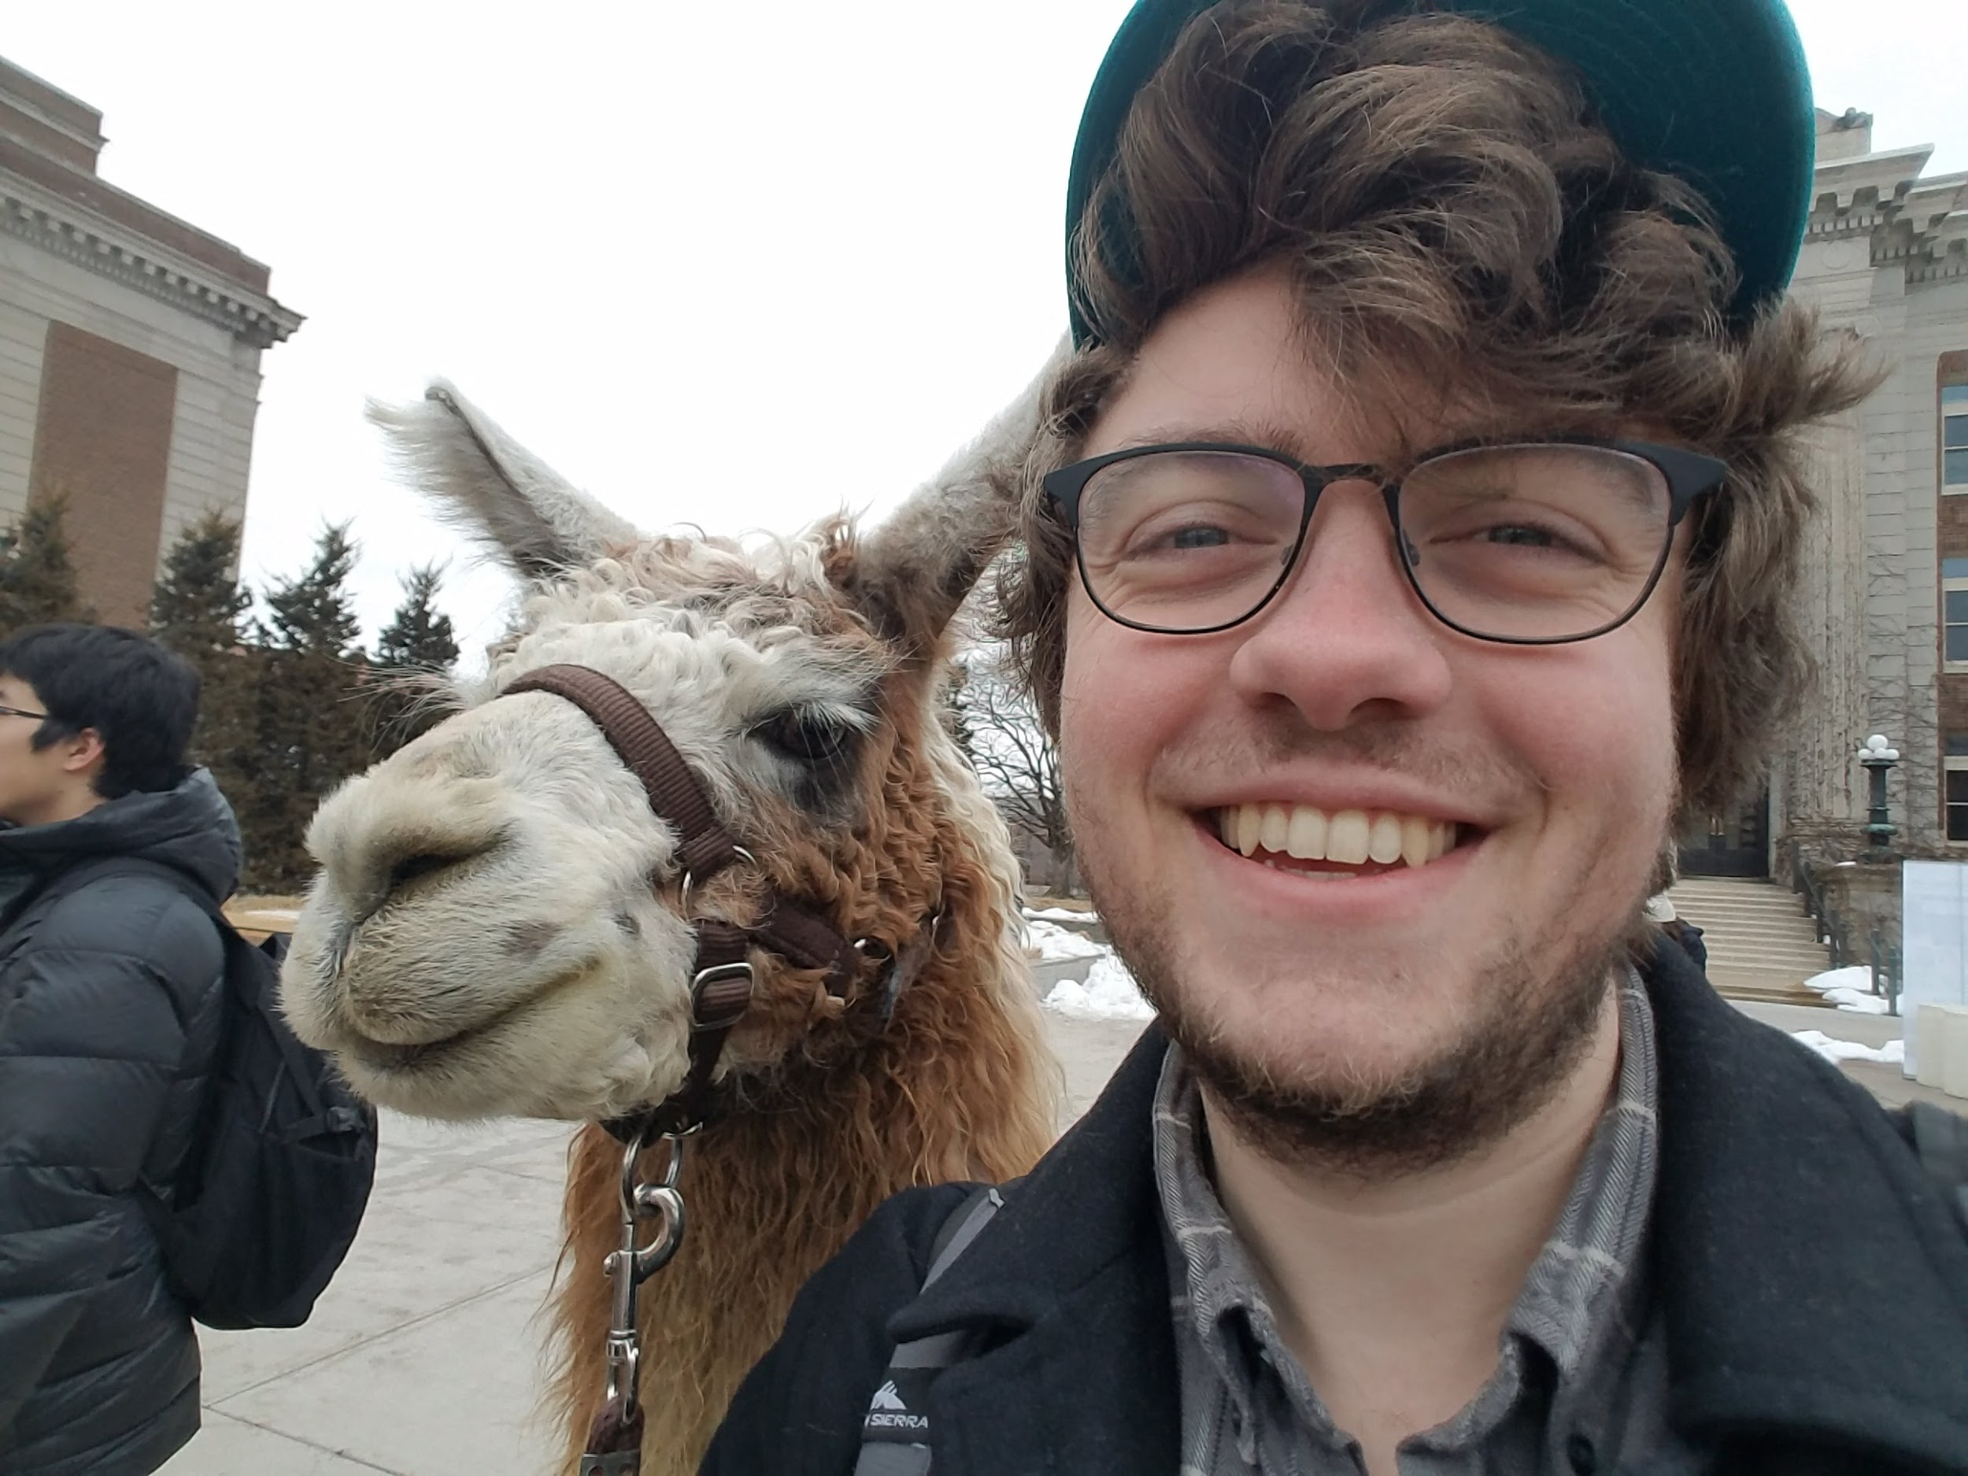

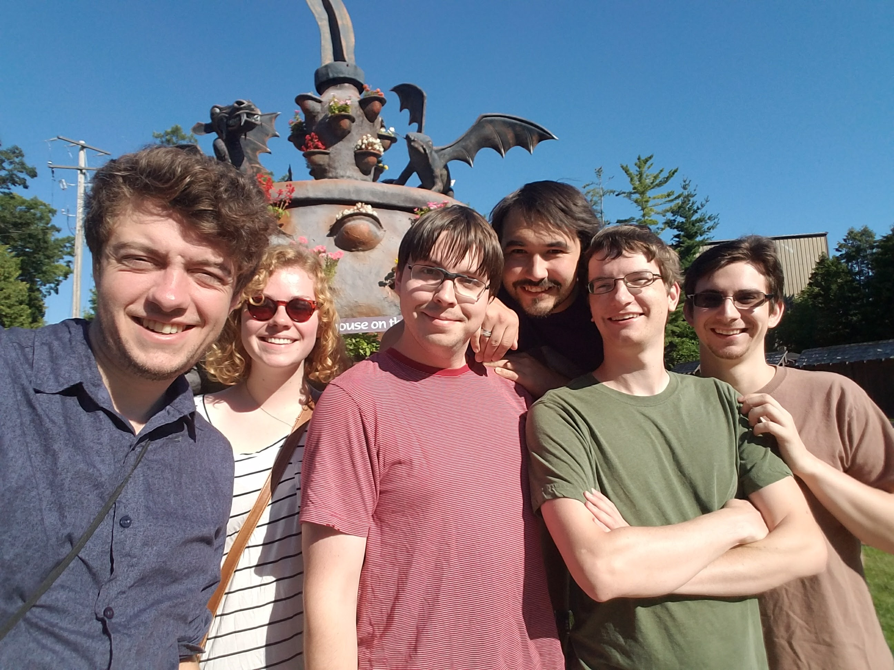
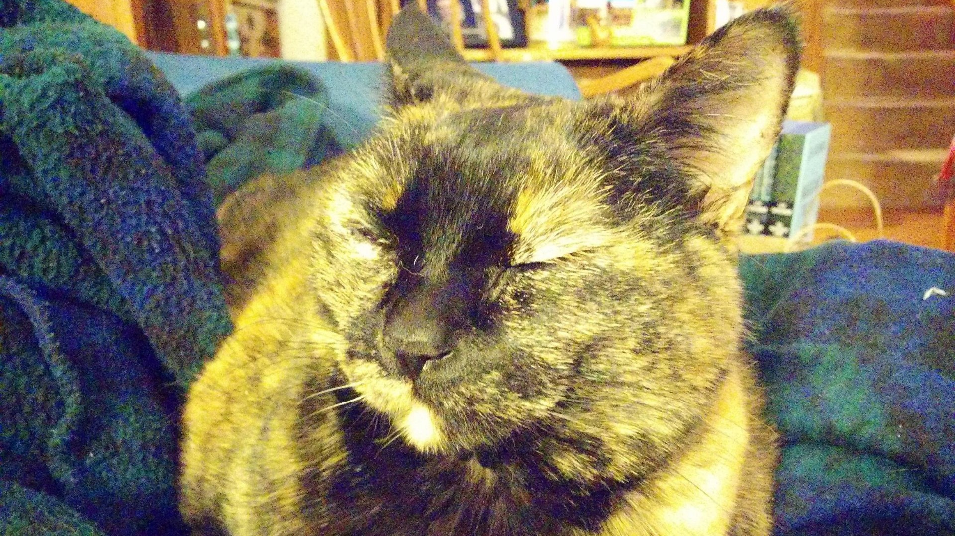

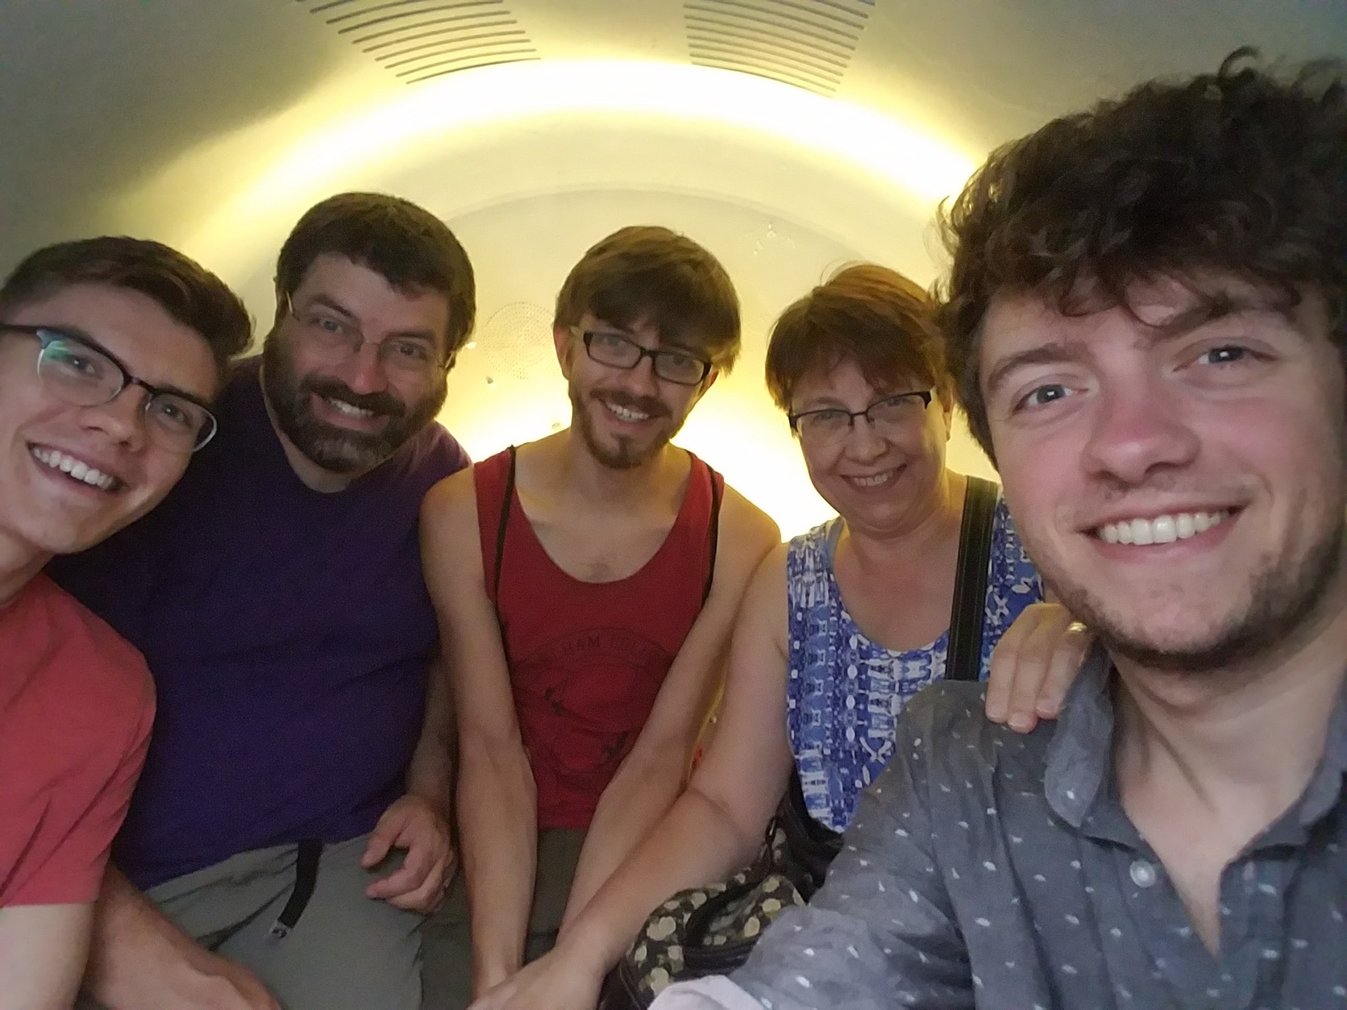
Sam Ihlenfeldt He/Him
Quantitative Methods in Education PhD student (4th year)
I’m from St. Paul, Minnesota. I went to Carleton College (’14) to study Statistics and Spanish.
Some fun facts about me:
Former competitive Magic player
Cat dad
Middle school cooking instructor?
Fan of going to “the movies”
Volunteer at the Farmer’s Market
Spend too much time on TikTok

Slide 5


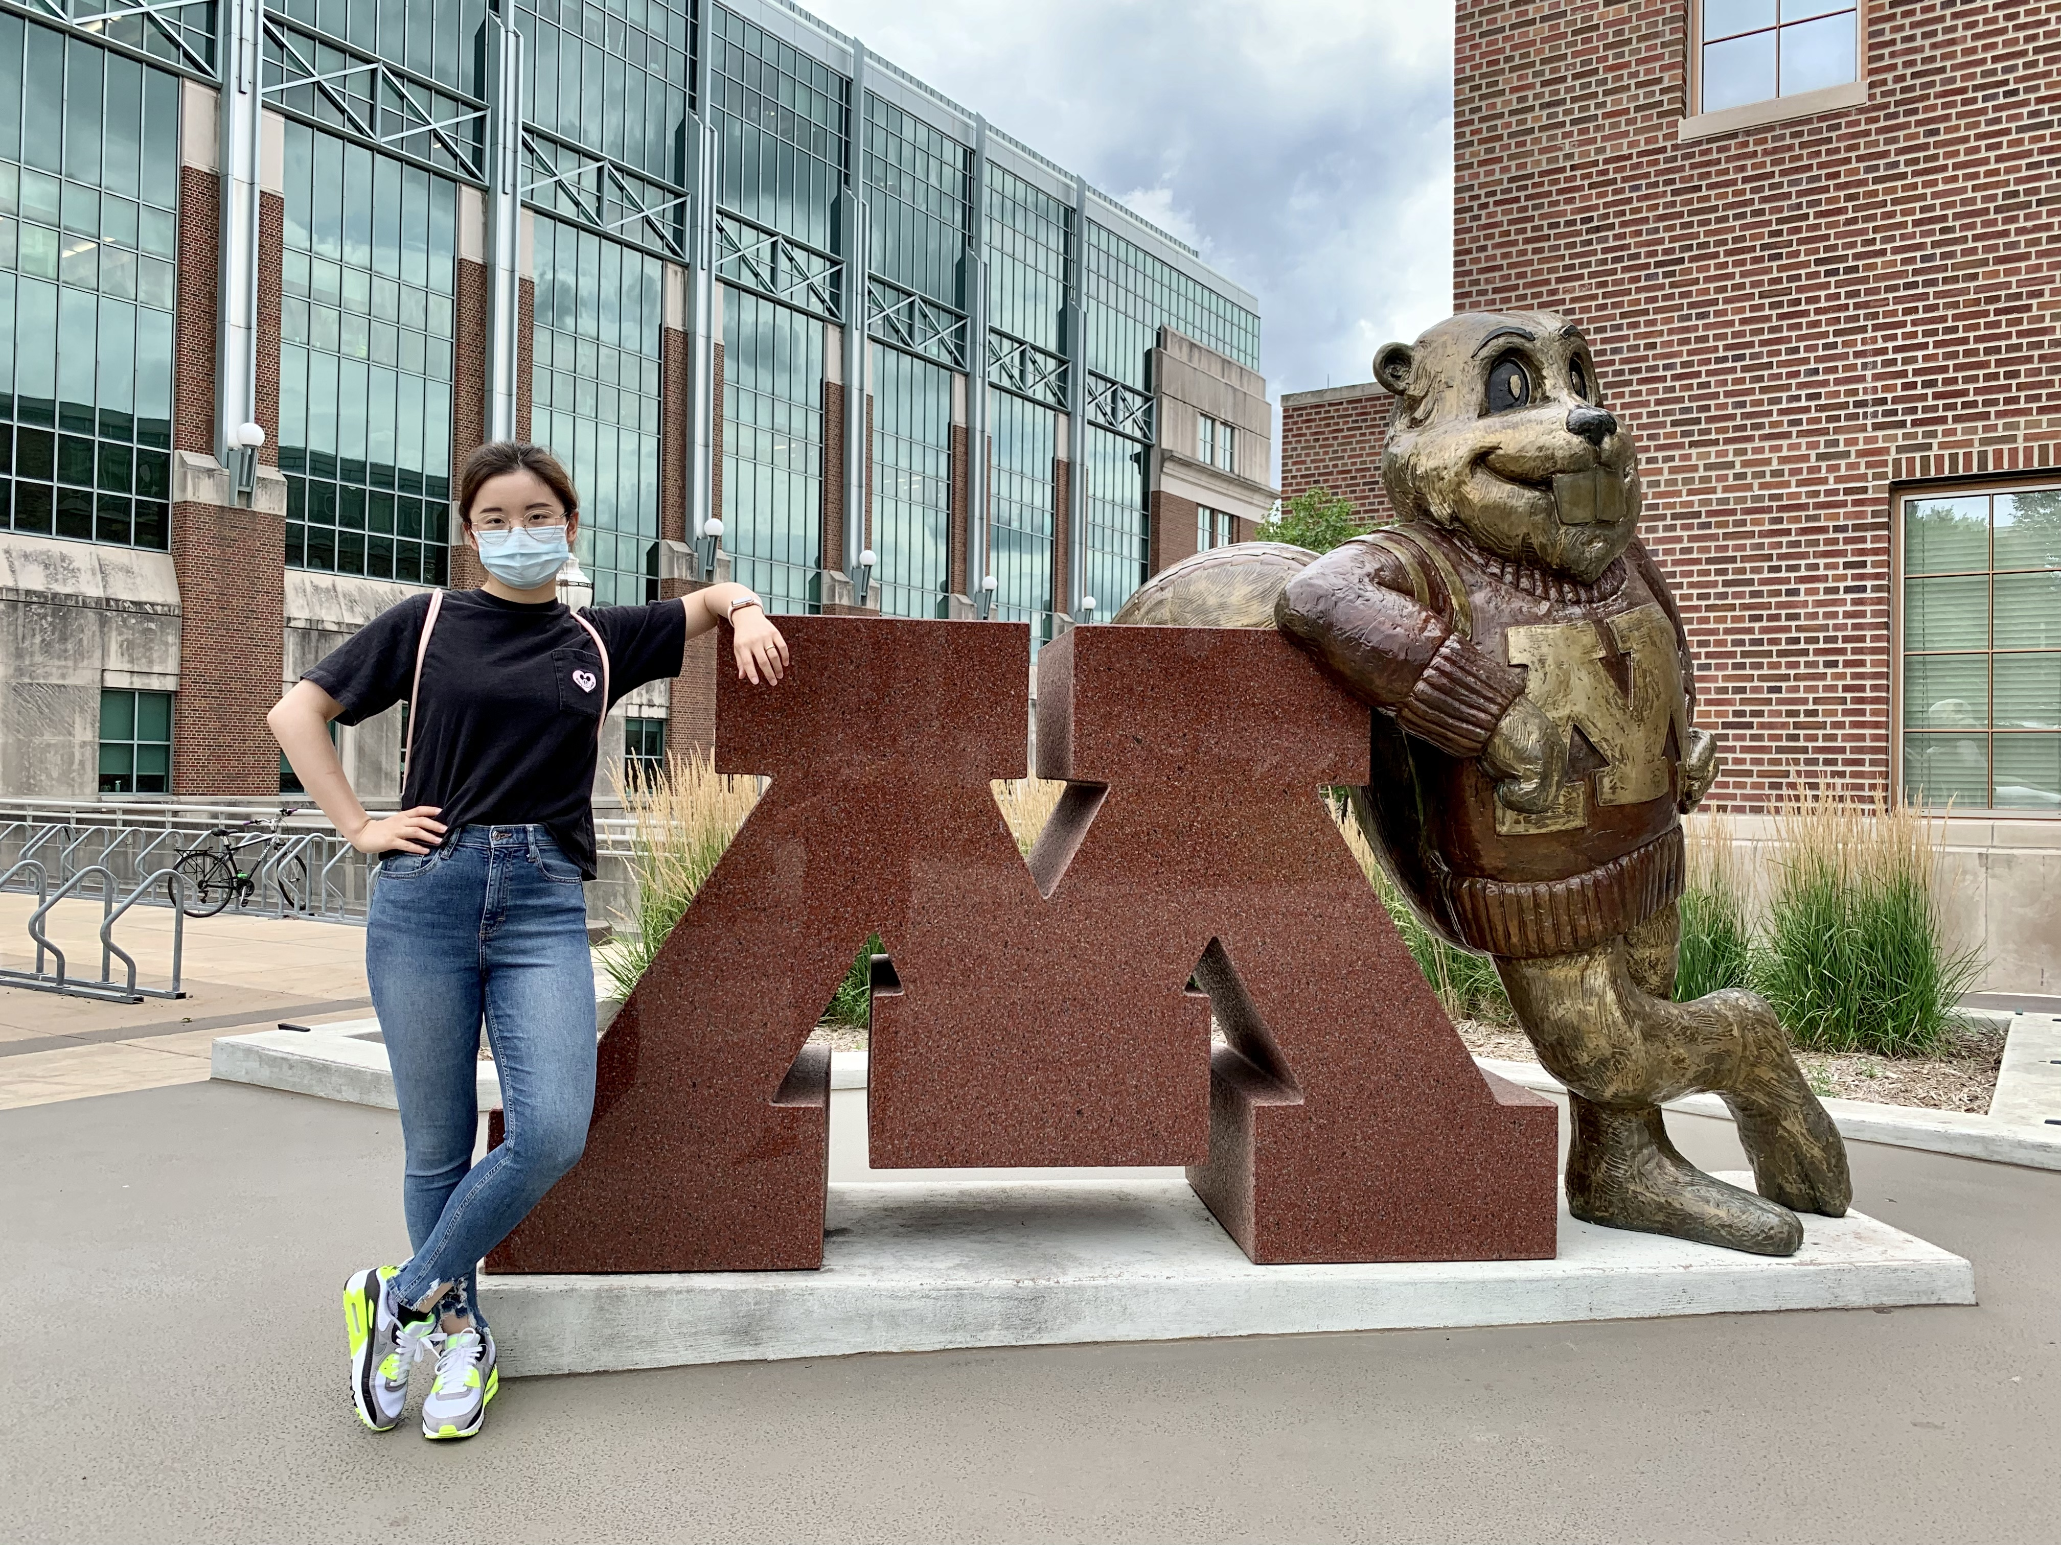
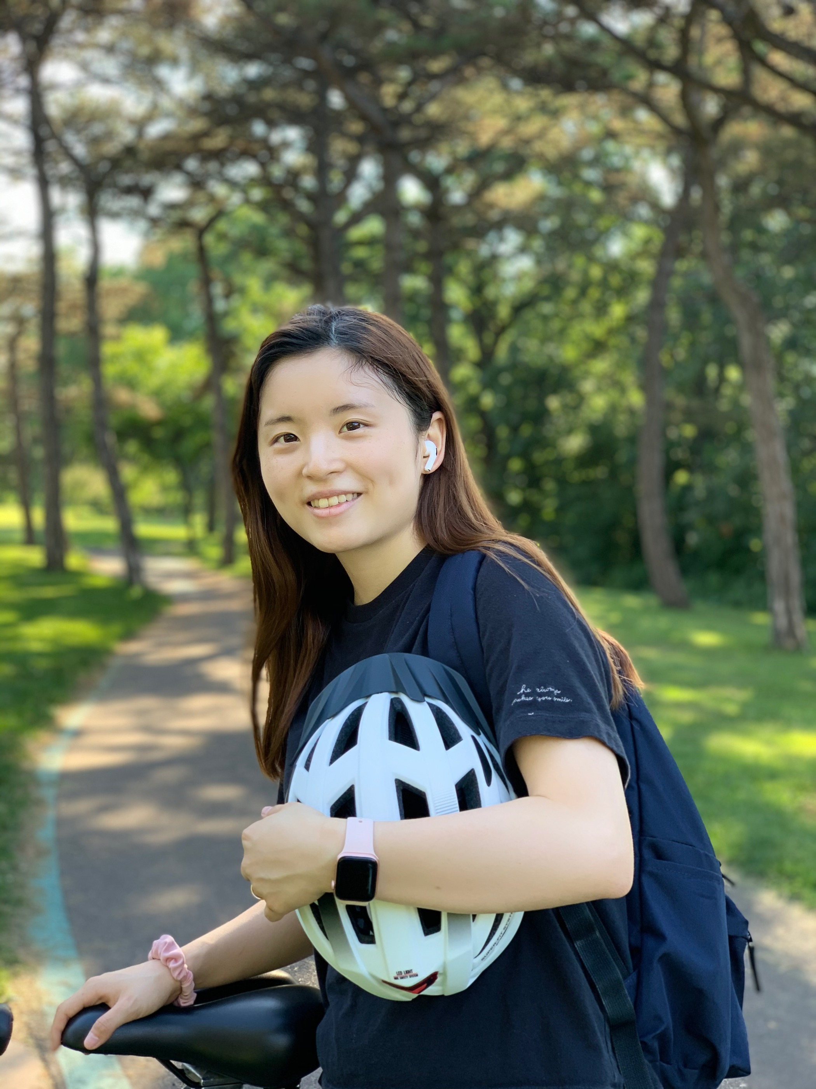
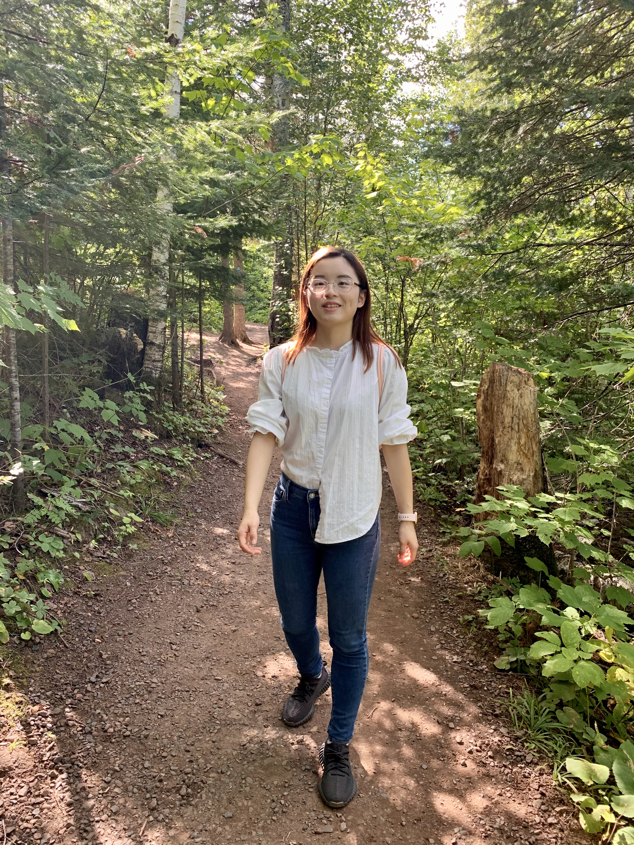
Jiayi Deng
She/Her
HKBU – KU – UMN
From China
Enjoy hiking, biking and traveling
Like spicy food.

Slide 6
Course Goals
What the course will do:
Teach the basics of Statistical inference through modeling and simulation
Introduce terms and procedures that will allow you to conduct and communicate statistical research
Explore the interdisciplinary nature of Statistics by posing questions from a variety of real-world scenarios
What the course will not do:
Require excessive computation or mathematics
Require the learning of a new programming language

Slide 7
Course Philosophy (For classwork)
Your job:
- Come prepared
- Be present to learn (ask questions!)
- Teach your classmates
Our job:
- Come prepared
- Be available (answer questions!)
- Guide your learning
Ideally, you will all get an A!
Flexibility is important, but so is communication.

Slide 8
Course Materials
Textbook (free!)
Lab Manual (also free!)
TinkerPlots
- Easy to use, no complex math needed!
- Available on AppsToGo
- Need to purchase $7 license
- For troubleshooting, please contact UMN IT
Everything is on Canvas!

Slide 9
Course Flow
Each day (give or take a few minutes):
Ungraded refresher question (5 min)
Introduction to lab work (15 min)
Lab work in groups (40 min)
Review and questions! (15 min)
Each unit (approximately every 3 weeks):
Meet new groups on the first day
Group quiz on the last day
Turn in your individual exam by midnight the following Friday

Slide 10
Breakdown of your grade…
Individual Assessments
More like a difficult homework assignment than a midterm exam
Each linked to a Unit
This is individual work and must be completed on your own.
Open book, open note
Each exam is worth 10% of your final grade. (5 x 10 = 50%)
Group Quizzes
Each quiz is worth 10% of your final grade. (5 x 10 = 50%)
Make-up quiz at the end of the semester.
Too many absences in a unit = taking quiz solo
Final Exam
None!

Slide 11
In your Unit 1 groups…
Introduce yourself (year, major, etc.)
Answer the question from before – most recent Youtube video or TikTok you watched (hopefully not since the beginning on class…)
Consider exchanging e-mails!
In your group, fill out the following discussion question posted to Canvas:
- What words come to mind when you think of statistics?
- What questions can statistics help us answer?
If you end up with extra time, please stick around until we come back together.

Slide 12
Getting Help
Sam’s office hours:
Monday and Wednesday, right after class!
Or by appointment!
Or by e-mail!
I will respond to most e-mails within 24h.
Jiayi’s office hours:
Wednesday, 3-4pm
Or by appointment!
Or by e-mail!
Other office hours:
Times and Zoom rooms for other TA’s office hours listed on Canvas

Slide 13
Getting Help
Your mental health is important to me!
I am flexible with exam extensions – please reach out to me at any point before they are due to work something out.
Attendance is required, but not graded. If you need to miss class for a day, let me know in advance so I can shuffle groups.
In both prior cases, you don’t need to give a reason if you don’t feel comfortable.
Help me help you! Let me know what you need. I am always available to listen.
If you need to talk to someone aside from me or Jiayi, a link to the UMN mental health resources web page is linked in the syllabus.

Slide 14
Any Questions? (I also have office hours now)

